Slide 1


Physical and Chemical Change
Intro

Slide 2






Physical And Chemical Card Sort
Use the cards provided to sort into two categories physical or chemical change.

Slide 3
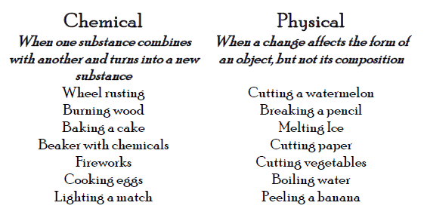
Answers

Slide 4

Questions
What criteria did you use to help you sort your cards?
Which cards did you find hard to place?
Using one sentence how do chemical can physical differ?

